Slide 1
Blazing Queries: Using an Open Source Database for High Performance Analytics
July 2010

Slide 2

AGENDA
Common Tuning Techniques
  Why queries run slowly
  Common Tuning Approaches
  A Different Approach
Infobright Overview
  The Company
  The Technology
  Performance Results
Getting Started

Slide 3

Why queries run slowly
Too much data
Too many users
Too much data
Poor query design
Too much data

Slide 4

Common Tuning Approaches
Indexing
Partitioning
More Processors
Summary Tables
Explain Plans

Slide 5
A Different Approach
Infobright uses intelligence, not hardware, to drive query performance:
  Creates information about the data (metadata) upon load, automatically
  Uses metadata to eliminate or reduce the need to access data to respond to a query
  The less data that needs to be accessed, the faster the response
What this means to you:
  No need to partition data, create/maintain indexes or tune for performance
  Ad-hoc queries are as fast as static queries, so users have total flexibility
  Ad hoc queries that may take hours with other databases run in minutes; queries that take minutes with other databases run in seconds

Slide 6

















Infobright
Innovation
  First commercial open source analytic database
  Knowledge Grid provides significant advantage over other columnar databases
  Fastest time-to-value, simplest administration
Cool Vendor in Data Management and Integration 2009
Partner of the Year 2009
Infobright: Economic Data Warehouse Choice
Strong Momentum & Adoption
  Release 3.3.2 generally available
  > 120 customers in 10 Countries
  > 40 Partners on 6 continents
  A vibrant open source community
      > 1 million visitors
      40,000 downloads
      7,500 community members
Notes:
NOTE – THIS DATA CHANGES FREQUENTLY SO CHECK FOR LATEST VERSION
Infobright was founded in 2006 by a team of internationally recognized mathematicians and is run by data management experts. We recognized that the critical need for business intelligence, coupled with the dramatic growth of corporate data, was outpacing the IT resources and budget within many companies.
Our mission is to enable companies of all sizes to be able to implement, manage and afford a scalable, analytic database as the foundation for analytic applications and data marts. Our technology does this by delivering a simple to use, scalable and low cost solution that eliminates up to 90% of the work typically required when implementing these kinds of systems. We provide both a Community Edition and Enterprise Edition of our technology to suit the needs of a diverse set of users.
The value proposition leverages the fact that our technology is easy to deploy and does not require a great deal of support and customization from IT. In addition our software requires a very small hardware footprint in relation to the size of raw data we support, meaning that IT can quickly delivery a high value application at lower cost than our competitors.
Through our integration with MySQL, we provide the highly scalable analytic database solution that is ideal for MySQL users. We also leverage the broad connectivity that MySQL has to BI and ETL tools so users can choose from a wide variety of products for this. Our strong partnership with Sun/MySQL resulted in their making an investment in Infobright this past September.
Infobright’s products are in their third major release, each of which has added significant new functionality. We have grown rapidly, with customers and partners around the globe. We have been recognized by a diverse set of industry leaders for technology innovation.
Our open source community is also growing rapidly, and our community edition download volume continues to grow.

Slide 7










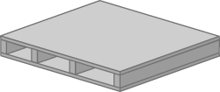

Infobright Technology: Key Concepts
Column orientation
Data packs and Compression
Knowledge Grid
Optimizer
Notes:
Our approach is to use the data within the database in a different way to alleviate problems in all of these areas .Our product, Infobright, is a scalable analytical database.
What this means is that we’ve designed a product that provides fast answers to complex questions, a product that deals with massive amounts of information, and a product that does so without any additional burdens on IT. Rather than using a brute-force approach with more hardware power to increase query performance, we use knowledge about the data itself to intelligently isolate the relevant information and return results more quickly.
Users are no longer limited to pre-determined queries and reporting structures, and the efforts of IT are reduced to a minimum. So how do we actually do this?
Infobright is a column-oriented database, and as each column is read in, it is divided vertically into groups of 65,536 row elements, referred to as Data Packs. So each column of data is defined in terms of a stack of Data Packs. As each Data Pack is loaded into an Infobright table, we extract statistical information about this data which we keep in the Knowledge Grid. The goal of the Knowledge Grid is to minimize the need to access data in order to resolve a query – as it knows from its metadata which data packs are relevant to a particular query and which are nor.
As Data Packs are created they are compressed individually using a iterative series of compression algorithms, giving us our industry-leading overall compression ratios of anywhere from 10:1 to 40:1. Data is read in without having to alter a business’s existing data model, and there are no indexes to build or maintain. The Knowledge Grid is build automatically during the load, and doesn’t require any work on the part of the user. And because Knowledge Grid information is generated only relative to the data being loaded, our incremental load speeds are constant, regardless of the growing size of the database.

Slide 8

1. Column vs. Row Orientation - Use Cases
ID | job | dept | city
#
#
#
#
#
#
Row-Based Storage
Row Oriented works if…
All the columns are needed
Transactional processing is required
#
#
#
#
#
#
ID
job
dept
city
Column-Based Storage
Column Oriented works if…
Only relevant columns are needed
Reports are aggregates (sum, count, average, etc.)
Benefits
Very efficient compression
Faster results for analytical queries
Column-Based Storage
id
job
dept
city
id
job
dept
city
#
#
#
#
#
#
#
#
#
#
#
#
8
Notes:
Each method has its benefits depending on your use case.
Row oriented databases are better suited for transactional environments, such as a call centre where a customer's entire record is required when their profile is retrieved.
Column oriented databases are better suited for analytics, where only portions of each record are required. By grouping the data together like this, the database only needs to retrieve columns that are relevant to the query, greatly reducing the overall I/O needed. And by contrast, returning a specific 'record' would require retrieving information from each column store.
Infobright is a column oriented database and built for high speed and complex analytical queries that ask questions about the data such as trends and aggregates, rather than questions that retrieve records from the data.

Slide 9
2. Data Packs and Compression
Data Packs
Each data pack contains 65,536 data values
Compression is applied to each individual data pack
The compression algorithm varies depending on data type and distribution
64K
64K
Compression
Results vary depending on the distribution of data among data packs
A typical overall compression ratio seen in the field is 10:1
Some customers have seen results of 40:1 and higher
For example, 1TB of raw data compressed 10 to 1 would only require 100GB of disk capacity
64K
64K
Patent Pending
Compression
Algorithms
Notes:
During the load process, each column of data is segmented into Data Packs of 64k, or 65,536 row elements. Then, for each Data Pack, Infobright applies multiple compression algorithms multiple times if necessary to achieve the highest compression ratio for that Data Pack.
The compression algorithms we use are a combination of industry standards and internally developed patent-pending Infobright algorithms and are chosen based on the data within the column.
The overall compression ratio for each Data Pack will depend on the data type and the repetitiveness of the data from one Data Pack to the next.
By addressing each Data Pack individually, we see that the compression varies within one column from one Data Pack to the next, and of course it varies from one column to the next as well.
This means that the overall compression ratio for the whole table can be very high. Typical compression achieved by our customers is 10:1, but we frequently see up to 30:1 and 40:1 compression.
Keep in mind that many databases with stated compression ratios of 5:1 and 10:1 will often add significantly to their footprint with indexes or projections, resulting in an overall storage requirement that can be equal to or greater than the original uncompressed data.
Our compression method means a significant savings in storage requirements, a lower Total Cost of Ownership, and reduced I/O since smaller volumes of data are being moved around.

Slide 10
3. The Knowledge Grid
Knowledge Grid
applies to the whole table
Knowledge Nodes
built for each Data Pack
Information about the data
Column A
Col A - INT
numeric
Col B - INT
Col B - CHAR
Data Pack Node
DP1
DPN
DP1
DP2
Histogram
Numerical Histogram
DP3
Built during
LOAD
DP4
CMAP
DP5
Character Map
DP6
Knowledge Nodes answer the query directly, or
Identify only relevant Data Packs, minimizing decompression
10
Notes:
The Knowledge Grid is a summary of statistical and aggregate information collected about each table as the data is loaded. Its information about the data. For each column and each Data Pack within that column, the Knowledge Grid information is collected automatically and up to 4 different types of Knowledge Nodes are built with no configuration or setup required in advance, .
Three of the Knowledge Nodes, called Data Pack Nodes, Numerical Histograms, and Character Maps, are built for each Data Pack during the load;
A 4th Knowledge Node, called a Pack-to-Pack Node, is built when a join query is run.
Because they contain summary information about the data within the table, the Knowledge Nodes are used as the first step in resolving queries quickly and efficiently by answering the query directly, or by identifying only relevant Data Packs within a table and minimizing decompression.

Slide 11
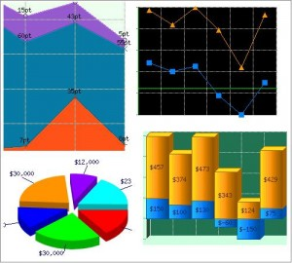
4. Optimizer
Type I Result Set
Knowledge Grid
Report
Query
1%
Q: How are my sales doing this year?





Type II Result Set
Compressed Data Packs
11
Notes:
When a query comes in, it’s run through the Infobright optimizer, which looks at the Knowledge Grid first to resolve the query. Because the Knowledge Grid stores aggregate information about the data from the Data Packs, the query can often be answered using only the Knowledge Grid, without having to look at the data specifically. The Knowledge Grid also stores information about the range of values within each Data Pack, so in cases where more detail is required, the Knowledge Grid will narrow the field of search to only those Data Packs relevant to the query, and then only decompress and read these relevant Data Packs.
Query received
Optimizer iterates on Knowledge Grid
Each pass eliminates Data Packs
If any Data Packs are needed to resolve query, only those are decompressed

Slide 12
How the Knowledge Grid Works
007
SELECT count(*) FROM employees
WHERE salary > 50000
AND age < 65
AND job = ‘Shipping’
AND city = ‘TORONTO’;
salary
age
job
city
Rows 1 to 65,536
All packs ignored
Find the Data Packs with salary > 50000
Find the Data Packs that contain age < 65
65,537 to 131,072
All packs ignored
Find the Data Packs that have job = ‘Shipping’
131,073 to ……
Find the Data Packs that have City = “Toronto’
All packs ignored
Now we eliminate all rows that have been flagged as irrelevant.
Finally we have identified the data pack that needs to be decompressed
Only this pack will be decompressed
Completely Irrelevant
Suspect
All values match
Notes:
Lets see how the knowledge grid is used to evaluate a simple query
SELECT DISTINCT CITY FROM employees
WHERE salary > 50000
AND age < 65
AND job = ‘Shipping’
AND city = ‘TORONTO’;
First looking at the constraint salary > 50000 we can eliminate a number of Data Packs packs using the min-max in the Data Pack Nodes
salary > 50000 – in this case 3 data packs were found to have no values greater than 50000 and 1 data pack was found to have all the values of salary > 50000
age < 65 flags 2 Data Packs as suspect and 2 Data Packs that have all values of age < 65
job = ‘Shipping’ flags 2 Data Packs as suspect
City = “Toronto’ eliminates 2 more Data Packs and flags 2 as suspect
Now we eliminate all rows that have been flagged as irrelevant and we now only have 1 Data Pack to decompress.
Actually if the query had been something like count(*), then no decompression would have been needed at all. The knowledge grid would have been able to answer the question directly.
12

Slide 13
Examples of Performance Statistics
Fast query response with no tuning
Fast and consistent data load speed as as database grows. Up to 300GB/hour on a single server
Customer’s Test | Row-based RDBMS | Infobright
Analytic queries | 2+ hours | < 10 seconds
Query (AND – Left Join) | 26.4 secs | .02 seconds
Oracle query set | 10 secs – 15 mins | 0.43 – 22 seconds
BI report | 7 hours | 17 seconds
Data load | 11 hours | 11 minutes
  “Infobright is 10 times faster than [Product X] when the SQL statement is more complex than a simple SELECT * FROM some_table. With some more complex SQL statements, Infobright proved to be more than 50 times faster than [Product X].”
  (from benchmark testing done by leading BI vendor)
Notes:
This data is all from customer testing – not Infobright’s. Performance always depends on many factors including the specific query, database size, datatype, hardware configuration etc. So, mileage will vary!
13

Slide 14

Real Life Example: Bango
Bango’s Need | Infobright’s Solution
Leader in mobile billing and mobile analytics services, SaaS model Received a contract with a large media provider 150 million rows per month 450GB per month on existing SQL Server solution SQL Server could not support required query performance Needed a database that could scale for much larger data sets, with fast query response Needed fast implementation, low maintenance, cost-effective solution | Reduced queries from minutes to seconds Reduced size of one customer’s database from 450GB to 10GB for one month of data
Query | SQL Server | Infobright
1 Month Report (5M events) | 11 min | 10 secs
1 Month Report (15M events) | 43 min | 23 secs
Complex Filter (10M events) | 29 min | 8 secs

Slide 15
Bear in Mind
  The unique attributes of column orientation in Infobright are transparent to developers.
The benefits are obvious and immediate to users.
  Infobright is a relational database
  Infobright observes and obeys SQL standards
  Infobright observes and obeys standards-based connectivity
    Design tools
    Development tools
    Administrative tools
    Query and reporting tools

Slide 16
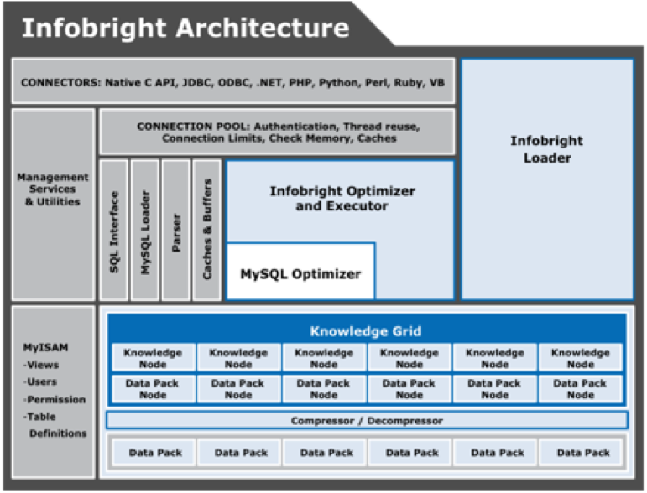
Infobright Architected on MySQL
  “The world’s most popular open source database”
Notes:
Infobright leverages the connectors and interoperability of MySQL standards. We are built within the MySQL architecture. This integration with MySQL allows our solution to tie in seamlessly with any ETL and BI tool that is compatible with MySQL.
For current MySQL users who are looking for a highly scalable analytic database, Infobright is ideal – It scales from hundreds of gigabytes to 50 terabytes and more, has the ease of use MySQL users expect, and uses the familiar MySQL administrative interface.
Simple scalability path for MySQL users and OEMs
No new management interface to learn
Enables seamless connectivity to BI tools and MySQL drivers for ODBC, JDBC, C/C++, .NET, Perl, Python, PHP, Ruby, Tcl, etc.

Slide 17

Infobright Development
When developing applications, you can use the standard set of connectors and APIs supplied by MySQL to interact with Infobright.
Connector/ODBC
Connector/NET
Connector/J
Connector/MXJ
Connector/C++
Connector/C
C API
PHP API
Perl API
C++ API
Python API
Ruby APIs
Note: API calls are restricted to the functional support of the Brighthouse engine. (e.g. mysql_stmt_insert_id )
Notes:
Since Infobright supports most of the data types available for a typical MySQL database implementation, if you are migrating an existing data warehouse or BI application, you can simply drop your existing data model into Infobright. On our community web page we have contributed software that help customer migrate to Infobright from either MySQL or other database platforms like SQL Server.
Data types that we are still working on include BLOBs and Auto Increment.
Customers that have specific needs for these datatypes have found some success by including MyISAM database objects with their implementation.
17

Slide 18
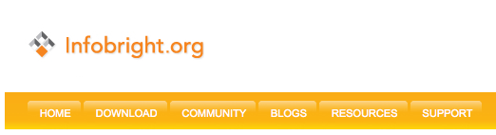

Get Started
At infobright.org:
  Download ICE (Infobright Community Edition)
  Download an integrated virtual machine from infobright.org
    ICE-Jaspersoft or ICE-Jaspersoft-Talend
  Join the forums and learn from the experts!
At infobright.com
  Download a white paper from the Resource library
  Watch a product video
  Download a free trial of Infobright Enterprise Edition, IEE

